Slide 1
Undirected Graphical Models
Yuan Yao
Peking University

Slide 2
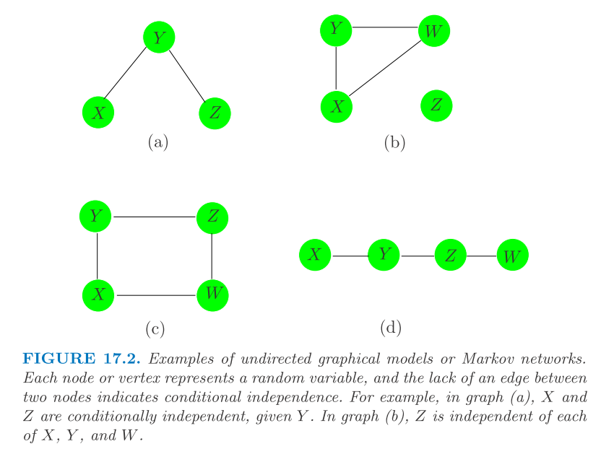
What’s a graphical model?

Slide 3
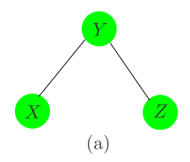
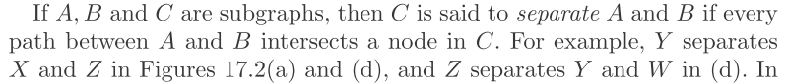
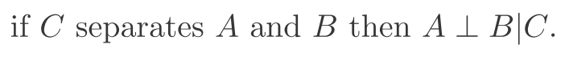
Markov property: Conditional Independence

Slide 4
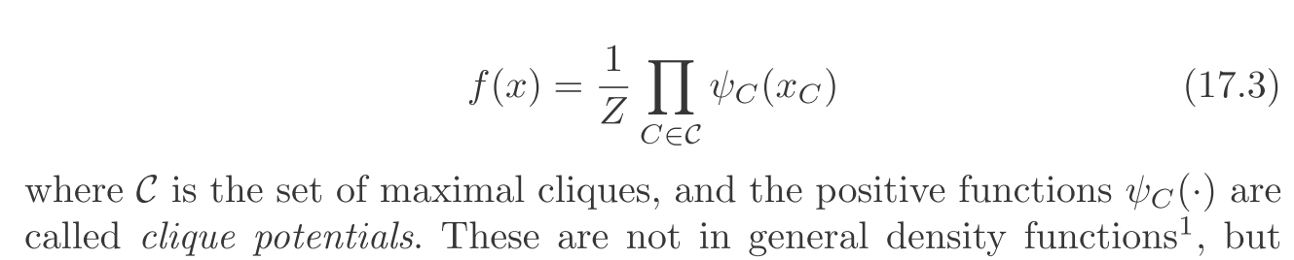
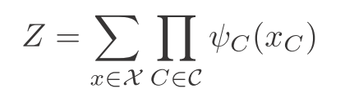
Hammersley-Clifford Theorem
A clique is a complete subgraph
A maximal clique is a clique where no other clique contains it
A joint probability admits the following factorization with cliques
where Z is the partition function

Slide 5
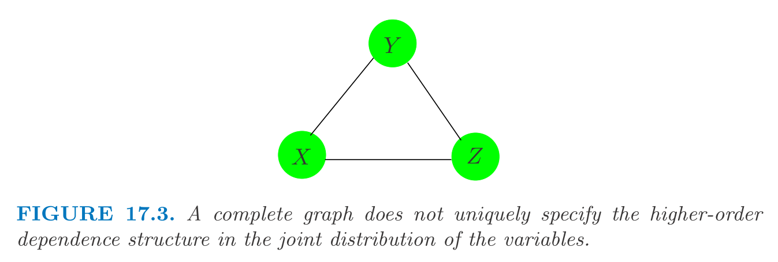
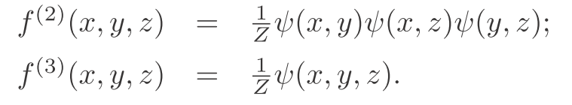
Clique Factorization is not unique

Slide 6
Example I: 西游记
west.Rdata
408-by-303 data matrix
The first column contains chapter ID (1,…,100)
302 characters appeared {1,0} in 408 scenes (samples)
16 main characters who appeared no less than 40 samples

Slide 7
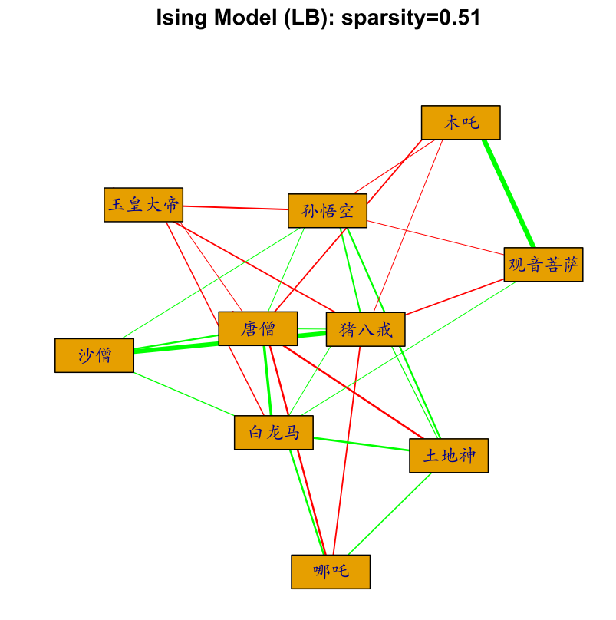
An Ising model
Green edges：positive interactions
Red edges: negative interactions

Slide 8
Example II: 红楼梦
dream.Rdata
475-by-375 data matrix
374 characters appeared {1,0} in 475 scenes (samples)
The first column is an indicator if the scene is in the first 80 chapters (by Xueqin Cao) or later (by E Gao)
18 main characters who appeared no less than 30 scenes in the first 80 chapters

Slide 9
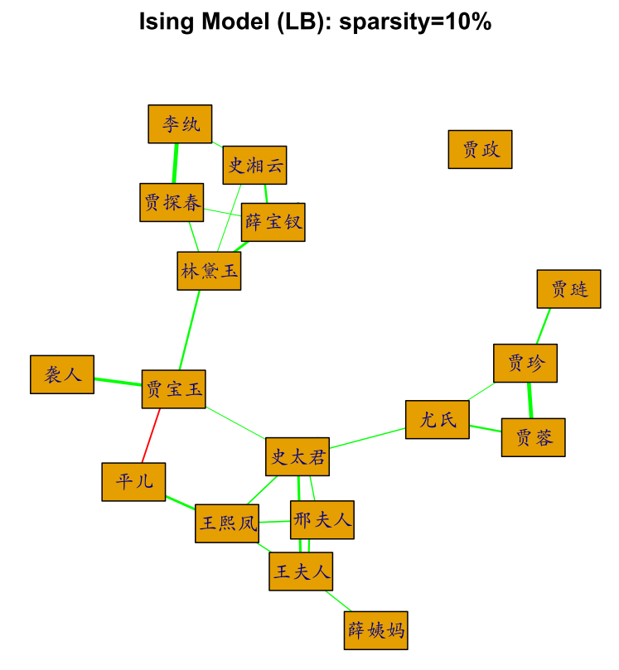
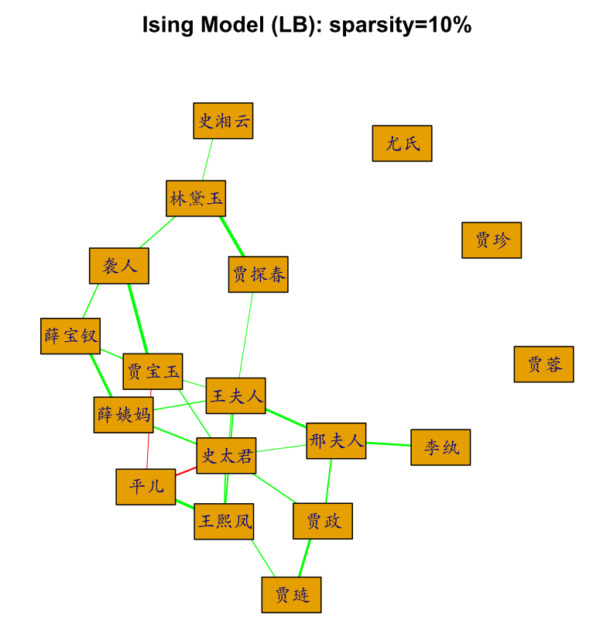
Left: 曹雪芹前80回； Right：高鹗后40回

Slide 10
Main Content
Gaussian Graphical Models for real random variables
Semiparametric Gaussian Copula Graphical Models
Ising Models (Boltzman Machine) for discrete random variables

Slide 11
Gaussian Graphical Model

Slide 12
Precision Matrix

Slide 13
Sparsity in High Dimensional Statistics

Slide 14
Gaussian Graphical Models

Slide 15
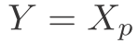
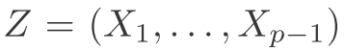
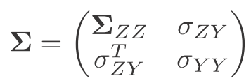
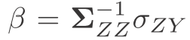
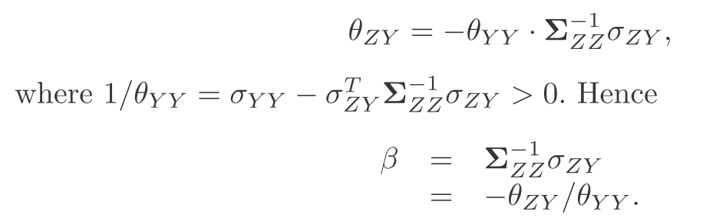
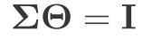
Proof:
Linear regression Y ~ Z whose coefficient:

Slide 16
Sparse precision matrix estimation

Slide 17
Neighborhood Selection

Slide 18
Recall:

Slide 19
Parallel LASSO

Slide 20
Estimator and Symmetrization

Slide 21
L1-penalized Maximum Likelihood Estimator (MLE)

Slide 22
Graphical LASSO, also known as

Slide 23
CLIME: motivation

Slide 24
CLIME: Dantzig Selector

Slide 25
CLIME as Linear Programming

Slide 26
Symmetrization

Slide 27
Nonconvex Penalized MLE

Slide 28
SCAD Penalty

Slide 29
Locally Linear Approximation: Adaptive LASSO

Slide 30
Reference

Slide 31
Normality?

Slide 32
Semiparametric Gaussian Copula Model

Slide 33
Nonparanormal Gaussian Model

Slide 34
Semiparametric Gaussian Copula Model

Slide 35
Conditional Independence

Slide 36
Nonparametric Part: Estimate of the marginal monotone transform

Slide 37
Rank Correlation

Slide 40
Semiparametric Graphical LASSO
R package: huge

Slide 41
Ising Model

Slide 42
A Brief History

Slide 43
Ising Model

Slide 44
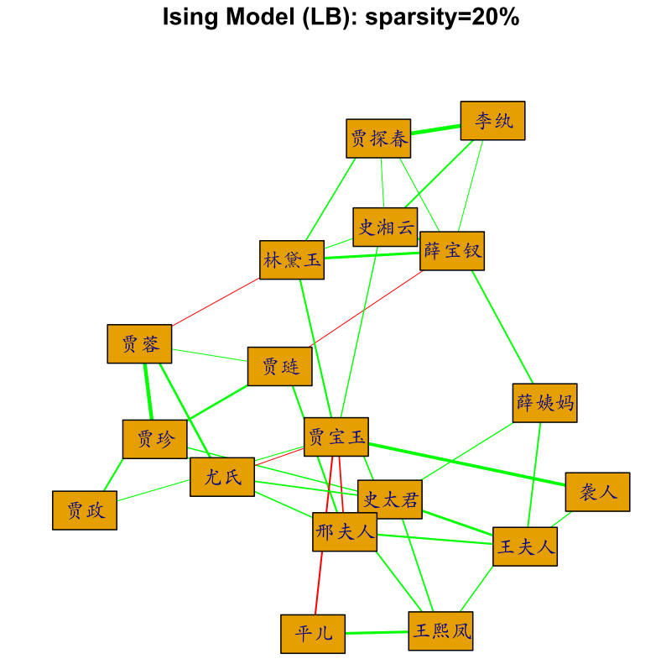
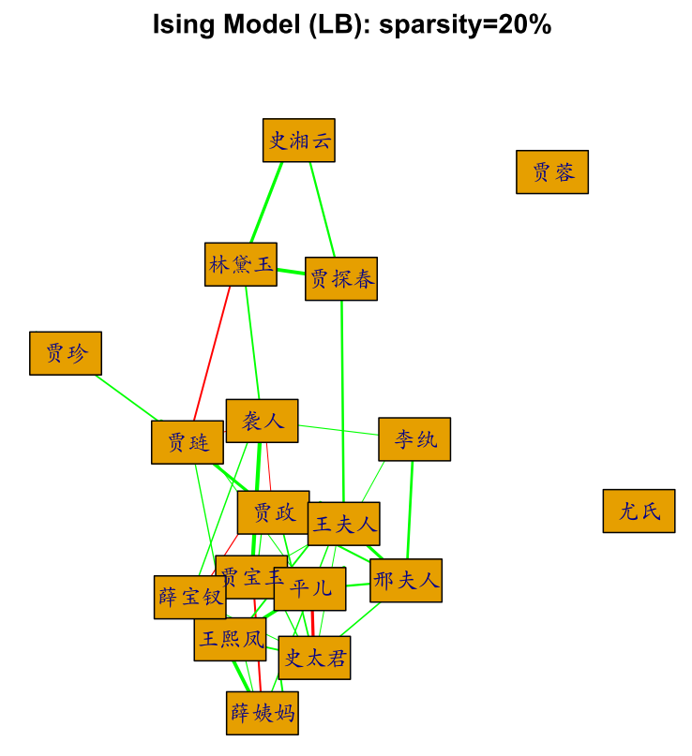
Sparsity

Slide 45
Boltzman Distribution

Slide 46
Penalized MLE

Slide 47
Sparsity Enforced Estimates

Slide 48
Partition function is intractable

Slide 49
Conditional Likelihood

Slide 50
Neighborhood Selection: L1-regularized Logistic Regression

Slide 51
Composite Conditional Likelihod

Slide 52
Penalized Composite Conditional Likelihood

Slide 53
Penalties

Slide 54
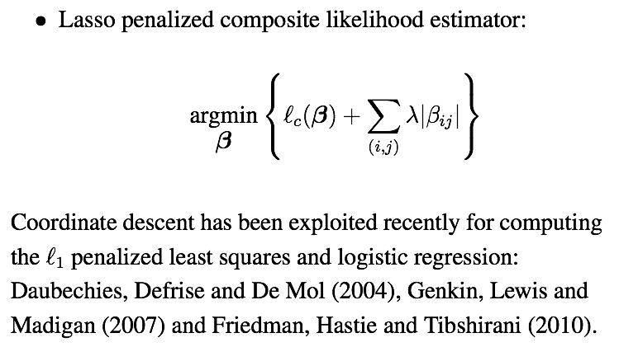
SparseIsing: LASSO-penalization R package, by Xue-Zou-Cai’2012

Slide 56
Algorithm

Slide 57
Alternative approach: Linearized Bregman Iteration
R package: Libra
Version 1.4

Slide 58
west.R
library(“Libra”)
data(“west”)
s0<-colSums(as.matrix(west))
data<-west[,s0>=20] #Important characters appeared more than 20
X<-as.matrix(2*data[,1:10]-1);
obj1 = ising(X,10,0.1,nt=1000,trate=100) #for version 1.4 or above
…
library('huge')
obj2<- huge(as.matrix(data), method = "glasso")
…

Slide 59
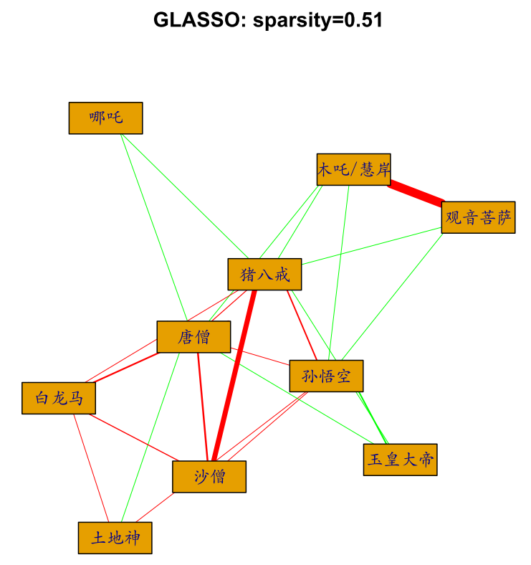
Which model is better, Ising or Gaussian?

Slide 60
Reference

